Slide 1
Transition information evening
https://youtu.be/2X0dBaYm3YE

Slide 2
OUR vision
To create an inclusive community where all are empowered to thrive, hold themselves accountable and achieve the highest standards. Our ethos of kindness and respect is lived and not just talked.

Slide 3
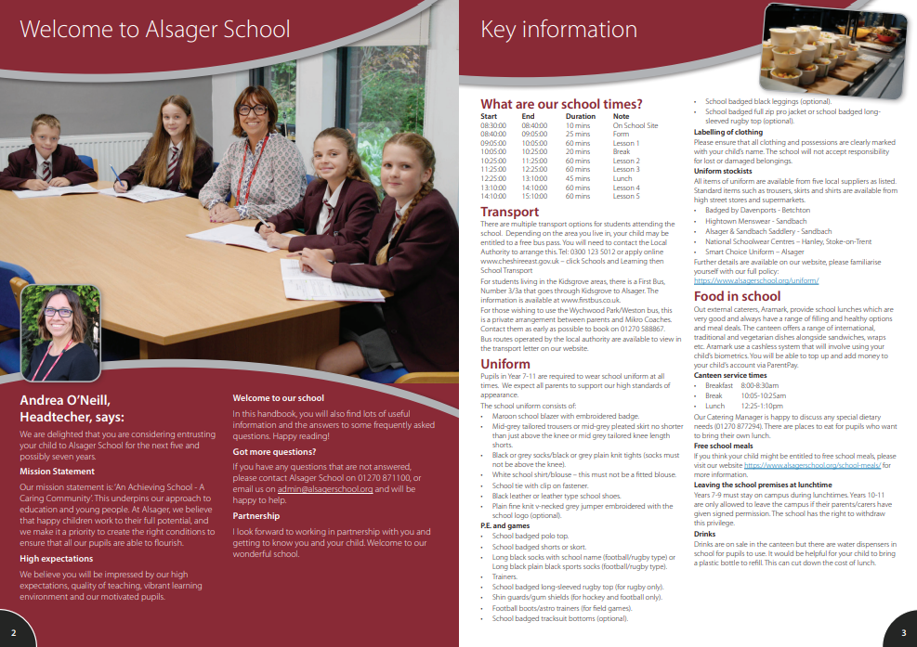
Guide to Parents About Us/Admissions/New Starters

Slide 4
Data Forms

Slide 5
High Standards
School uniform
Behaviour in classrooms –Behaviour for Learning grades (BfL) 1,2,3,4,5,6,7,8,9
Behaviour around the school - respectful
Behaviour around Alsager
Equipment – prepared for learning
Commitment to learning

Slide 6
School Uniform This is the Alsager Way
‘A Guide For Parents’ details our School Uniform policy for students and where you can find stockists. There is also a link on the website.
Alsager School standards for all students:
Hair for boys and girls
Makeup and nail varnish/fake nails
Piercings
Skirt length
CONDUCT CARD
‘Visible certainty amongst staff and students to allow exceptional behaviour to flourish’

Slide 8
‘The culture is set by the way that the adults behave’ Paul Dix
Pupil relationships and friendships.
Pupil conflict.
We are human!
Supporting the school’s standards by demonstrating a ‘united front’ with school.
Standards apply to all children.
Role modelling to children how we as the adults manage conflict and communicate appropriately.

Slide 9
The Alsager Way
‘Visible consistency making everyone feel safe.’
‘The culture is set by the way that the adults behave’
We aspire for the ‘kind of consistency that great parents have. You get the same from each, the same boundaries, the same mantras’.

Slide 11
Supporting parents as their children transition through or between schools.
Including all groups of parents in supporting their children's learning and developing their own learning.
Taking steps to ensure that the school is a welcoming, communicative and friendly place for parents.
Providing clear and accessible guidance to help parents support their children's learning and development.
Providing clear guidance on the responsibilities of parents, school and pupils, and sharing this information with parents as a key part of the induction process.
Producing parent-friendly policies to establish effective home–school links.

Slide 12
How will my child be grouped?
College and form allocated using sibling information and information shared at Primary transition meetings
Form time 8.40-9.05 am every day
One 1-hour lesson per week (SPIRIT)

Slide 13
How will my child be grouped?
Core Subjects (English, Maths and Science) | Foundation Subjects
Students are put into groups using Key Stage 2 SATs information and other information shared by Primary school. | Students are typically taught in mixed ability groups.
Group changes
There will be an opportunity based on additional assessments/progress of pupils throughout the year to change groups. Parents will be informed if this happens.

Slide 14
Parent Portal
Our Parent Portal is our way of communicating effectively with you.
Accounts will be created automatically for parents/carers in the next few weeks.
Information that can be viewed through the portal includes timetables, behaviour, reports and contact details can be updated.
We encourage all our parents/carers to login regularly/daily to see how your child is doing.
Any questions about our parent portal should be emailed to admin@alsagerschool.org

Slide 15
Reports and Parents’ Evenings
Parents Evenings
Pupil reports
Year 7 Settling In Evening
Thursday 25th September 2025
Form Tutors, Mr Pearce and Heads of College.
Year 7 Parents Evening
April 2026
Subject teachers, Mr Pearce and Heads of College.
Year 7 Settling in report
December 2025
To include information on BfL and Attendance.
Report 1 & 2
March & June 2026
To include information on achievement in each subject along with BfL and Attendance.

Slide 16
Y6 Transition day Wednesday 2nd July 2025
Arrive at the front of school for a 9.00am start
Assembly and time with their form tutor/HoC/SLT & Prefects
A variety of 3 lessons
20-minute break (bring a drink and snack)
Lunch in Best Bite (Provided free of charge, can bring packed lunch)
Time to relax and play some sport
Music production
2.45pm end of school day at the Leisure Centre courtyard
Questions regarding transition directed to transitionteam@alsagerschool.org

Slide 17
Contextual Safeguarding

Slide 18
Parents in Partnership
To make a donation, follow the instructions under DONATE, which is on our website mainpage

Slide 19
Monday 30th June
Royce - Miss Monaghan HHH
Moreton – Mrs Broad/Mr Bamba PE3

Slide 20
Tuesday 1st July
Dod – Miss Salt PE3
Lovell – Mrs Richardson HHH

