Slide 2
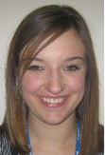
Introductions
Mr Seydou Bamba
Head of College
Mrs Sally Martin
Senior Leadership Link

Slide 3
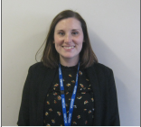
7SSK Mrs Skingle

Slide 4
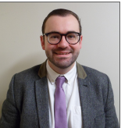
7AML Mr McLaren

Slide 5
7ADU Mr Durber

Slide 6
Moreton College
Named after Elizabeth Moreton who bequeathed Little Moreton Hall to the National Trust
Our College colour is Green
Charity
College Cup and Collegiate Pride

Slide 7
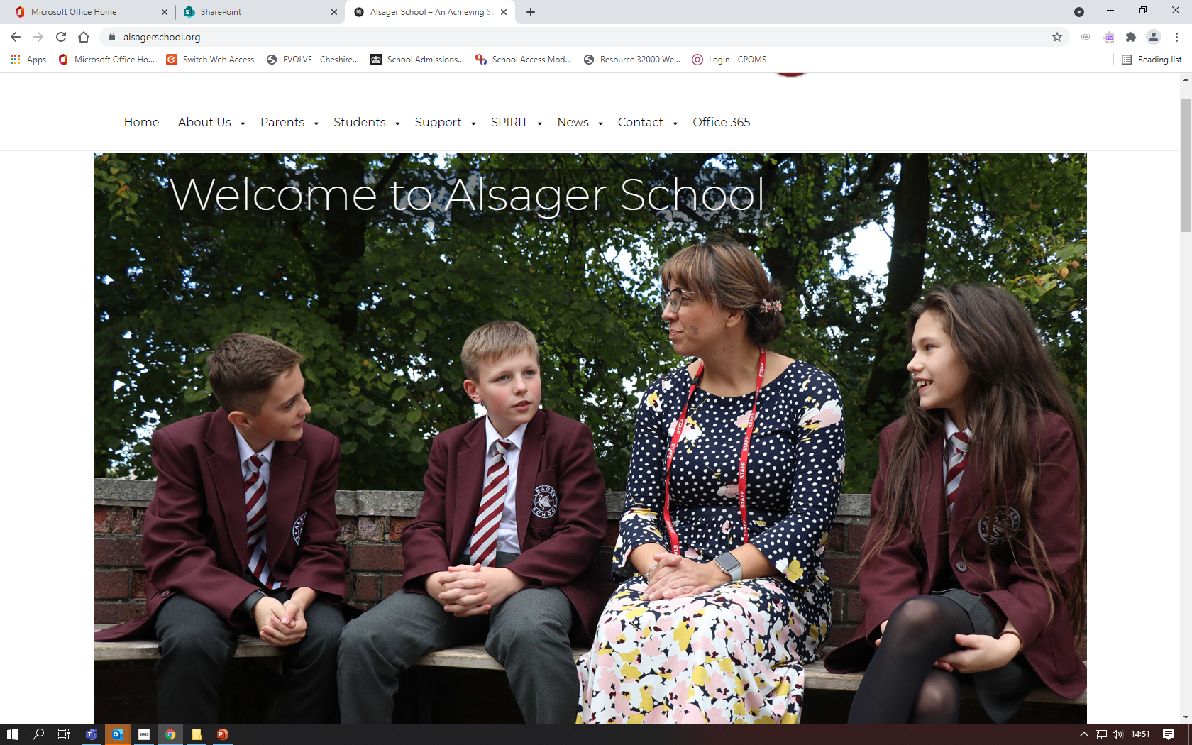
Alsager School Website

Slide 8
Our Prefect Team

Slide 9
Uniform guidance/ expectations
Outdoor coats should be waterproof and are only permitted outdoors​
Piercings – one small stud in each ear lobe​
No jewellery/ bracelets or rings – with the exception of wrist watch and one charity band.​
Hair colour should be natural​
Extreme hairstyles are not permitted incl. skin fades or extreme fades ​
Shoes need to be a leather type shoe – logo is a no go!​
If you child is unable to comply, please speak to us

Slide 10
New for September
A bespoke programme to guide Year 7 into high school. We will give a step-by-step introduction to settling in .
Activities include :-
•How to find your way around school
•Team building and becoming part of our community
•Introduction to everyday routines
•Joining an extra curricular club
•Who to speak to if your need support
•Inspiration for success

Slide 11
Technology
Valuables remain the responsibility of the student. Alsager School cannot accept responsibility for any loss or damage.
Mobile phones
Mobiles are not to be used on the school site during the day. They should remain switched off and in your child's bag
All contact with your child during the school day should be made via the school

Slide 12
How can I help my Child?
Check your child’s organiser daily
Talaxy – parent portal
Encourage your child to pack their bag the night before
Make sure they have all their equipment
Encourage them to make friends, relax, enjoy their day and get involved in the Alsager way

Slide 13
Attendance
Department for Education Regulations from September 2013
Parents should not take students on holiday during term time.
A request for holiday absence should be addressed to the Headteacher and should only be for exceptional circumstances
The Headteacher makes the decision whether the request will be authorised or not
A full version of Alsager School’s Attendance Policy is available to view on the schools website, www.alsagerschool.org

Slide 14
Behaviour for Learning
BFL is a system designed to encourage our students to behave in a manner which enables learning.
There are a number of rewards and celebrations for students who achieve 2s and 1s in their lessons.
We want to celebrate this excellent behaviour as we know it impacts positively on learning
There are a number of BFL grades
1 & 2 these are the ones you want to see
3 & 4 not the ones you want to see
5,6,7,8,9 mean something very different

Slide 15
First Day
•Arrive at school at 8 :30 for an 8:40 start
•We have our bespoke new starter programme to guide them into High school
•Full uniform is required including school bag and pencil case
•We can’t wait for them to start their journey!

