Slide 1
Dod College

Slide 2
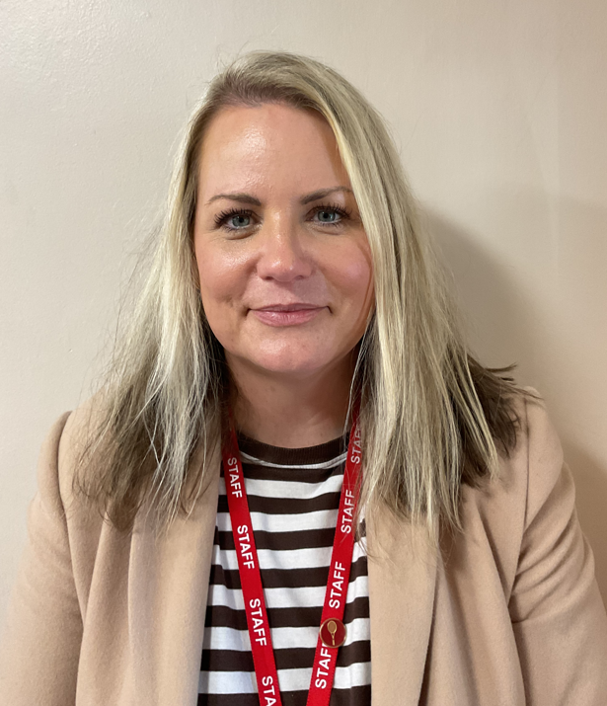
Introduction
Miss Salt
Head of College
Mr Pearce
Senior Leadership Link

Slide 3
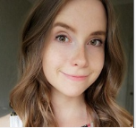
Year 7 Form Tutors
7LTA
Miss Taylor
7KHA
Miss Hamilton

Slide 4
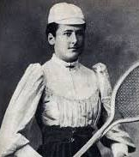
Dod College
Named after Lottie Dod
Charlotte Dod (24 September 1871 – 27 June 1960) was an English multi-sport athlete, best known as a tennis player. She won the Wimbledon Ladies' Singles Championship five times, the first one when she was only 15 in the summer of 1887. She remains the youngest ladies' singles champion.
College Colour is Red.
Motto:
College cup and collegiate pride

Slide 5
Alsager school website

Slide 6
New for September!
A bespoke programme to guide Year 7 into high school. We will give a step-by-step introduction to settling in.
Activities include :-
How to find your way around school
Team building and becoming part of our community
Introduction to everyday routines
Joining an extra curricular club
Who to speak to if your need support
Inspiration for success

Slide 7
Uniform guidance/ expectations
Outdoor coats should be waterproof and are only permitted outdoors.
Standards cards.
Piercings – one small stud in each ear lobe.
No jewellery/ bracelets or rings – with the exception of a wrist watch and one charity band.
Hair colour should be one natural colour.
Extreme hairstyles are not permitted, including shaved designs.
Black leather look shoes – a logo is a no go !
If for any reason your child can’t comply with uniform policy, please contact college office

Slide 8
Technology
Valuables remain the responsibility of the student. Alsager School accepts no responsibility for any loss or damage.
Mobile phones
Mobiles or smart watches are not to be used on the school site during the day.
All contact with your child during the school day should be made via the school.

Slide 9
How can I help my Child?
Check your child’s organiser daily.
Please sign it weekly.
Encourage your child to pack their bag the night before.
Make sure they have all their equipment daily

Slide 10
Pupil Attendance
Holidays in term time
Department for Education Regulations from September 2013
Parents should not take students on holiday during term time.
A request for holiday absence should be addressed to the Headteacher and should only be for exceptional circumstances
The Headteacher makes the decision whether the request will be authorised or not
A full version of Alsager School’s Attendance Policy is available to view on the school website, www.alsagerschool.org

Slide 11
Behaviour for Learning
There are a number of rewards and celebrations for students who achieve 2s and 1s in their lessons.
We want to celebrate this excellent behaviour as we know it impacts positively on learning
Golden tickets no negative BFL a week
Attendance stars and
Burgundy and Black Swan pin for progress
There are a number of BFL grades
1 & 2 these are the ones you want to see
3 & 4 not the ones you want to see
6,7,8,9 mean something very different

Slide 12
First day
Arrive at school at 8:30 for an 8:40 start
We have our bespoke new starter programme to guide them into High school
Full uniform is required including school bag and pencil case
We can’t wait for them to start their journey!

