Slide 1

Transition information evening
https://youtu.be/2X0dBaYm3YE

Slide 2
OUR vision
To create an inclusive community where all are empowered to thrive, hold themselves accountable and achieve the highest standards. Our ethos of kindness and respect is lived and not just talked.

Slide 3

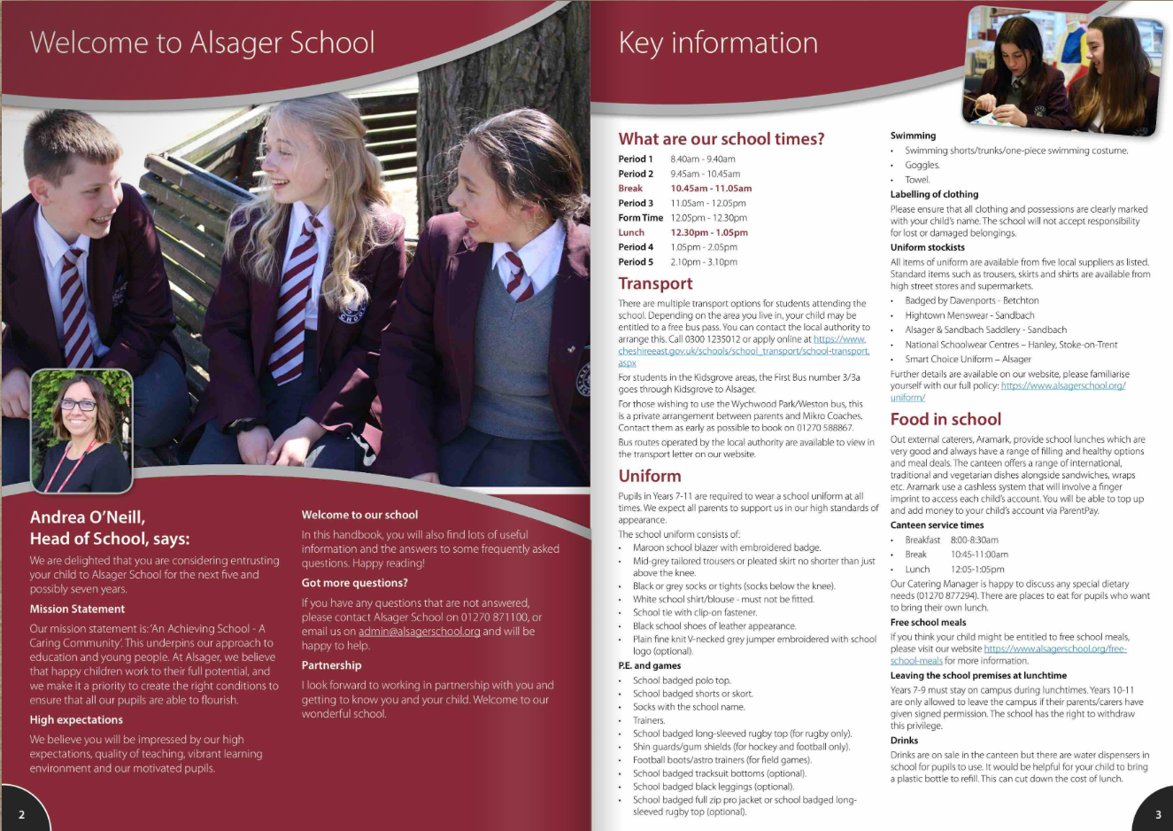
Guide to Parents About Us/Admissions/New Starters

Slide 4
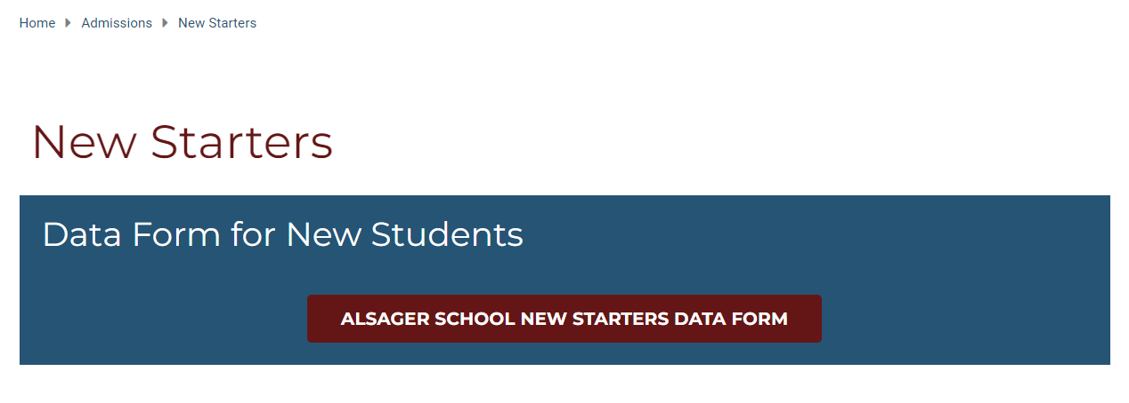
Data Forms

Slide 5
High Standards
School uniform
Behaviour in classrooms –Behaviour for Learning grades (BfL) 1,2,3,4,6,7,8,9
Behaviour around the school - respectful
Behaviour around Alsager
Equipment – prepared for learning
Commitment to learning

Slide 6
School Uniform
This is the Alsager Way
‘A Guide For Parents’ details our School Uniform policy for students and where you can find stockists. There is also a link on the website.
Alsager School standards for all students:
Hair for boys and girls
Makeup and nail varnish/fake nails
Piercings
Skirt length
CONDUCT CARD
‘Visible certainty amongst staff and students to allow exceptional behaviour to flourish’

Slide 7
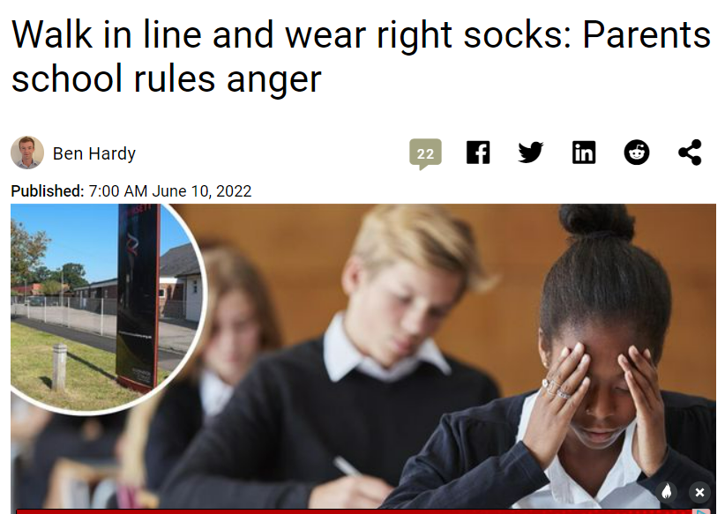
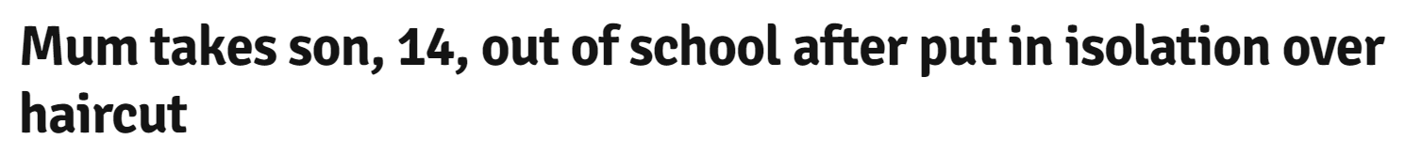

Slide 8


‘The culture is set by the way that the adults behave’ Paul Dix
Pupil relationships and friendships.
Pupil conflict
We are human!
Supporting the school’s standards by demonstrating a ‘united front’ with school.
Standards apply to all children.
Role modelling to children how we as the adults manage conflict and communicate appropriately.

Slide 9
The Alsager Way
‘Visible consistency making everyone feel safe.’
‘The culture is set by the way that the adults behave’
We aspire for the ‘kind of consistency that great parents have. You get the same from each, the same boundaries, the same mantras’.

Slide 10
How will my child be grouped?
College and form class allocated using sibling information and information shared at Primary transition meetings
Form time once every day
One 1-hour lesson per week (SPIRIT)

Slide 11
How will my child be grouped?
Core Subjects (English, Maths and Science) | Foundation Subjects
Students are put into sets using Key Stage 2 SATs information. | Students are typically taught in mixed ability groups.
Set changes
There will be an opportunity based on additional assessments/progress of pupils throughout the year to change sets.

Slide 12
Parent Portal
Our Parent Portal is our way of communicating effectively with you.
Accounts will be created automatically for parents/carers on the first day of school in September. You will receive an email with login instructions.
Information that can be viewed through the portal includes timetables, messages, behaviour, reports, contact details and even what your child has purchased in our canteen for lunch.
We encourage all our parents/carers to login regularly and there is a WebApp available for your convenience.
Any questions about our parent portal should be emailed to admin@alsagerschool.org

Slide 13
Reports and Parents’ Evenings
Parents Evenings
Pupil reports
Year 7 Settling In Evening
End of September 2024
Form Tutors, Mr Pearce and Heads of College.
Year 7 Parents Evening
April 2025
Subject teachers, Mr Pearce and Heads of College.
Report 1
March 2025
To include information on BfL and attendance.
Report 2
June 2025
To include information on achievement in each subject along with BfL and attendance.

Slide 14
Y6 Transition day
Wednesday 3rd July 2024
Arrive at the front of school for a 9.00am start
Assembly and time with their form tutor/HoC/SLT
A variety of 3 lessons
15-minute break (bring a drink and snack)
Lunch in Best Bite (Provided free of charge, can bring packed lunch)
Time to relax and play some sport
Music production
2.45pm end of school day at the Leisure Centre courtyard
Questions regarding transition directed to transitionteam@alsagerschool.org

Slide 15

Wednesday 28th and Thursday 29th August 2024
Closing date Thursday 4th July 2024
Further opportunity for your child to work alongside their peers and get to know the school before September
Wide range of activities
Questions should be directed to SummerSchool@AlsagerSchool.org

Slide 16
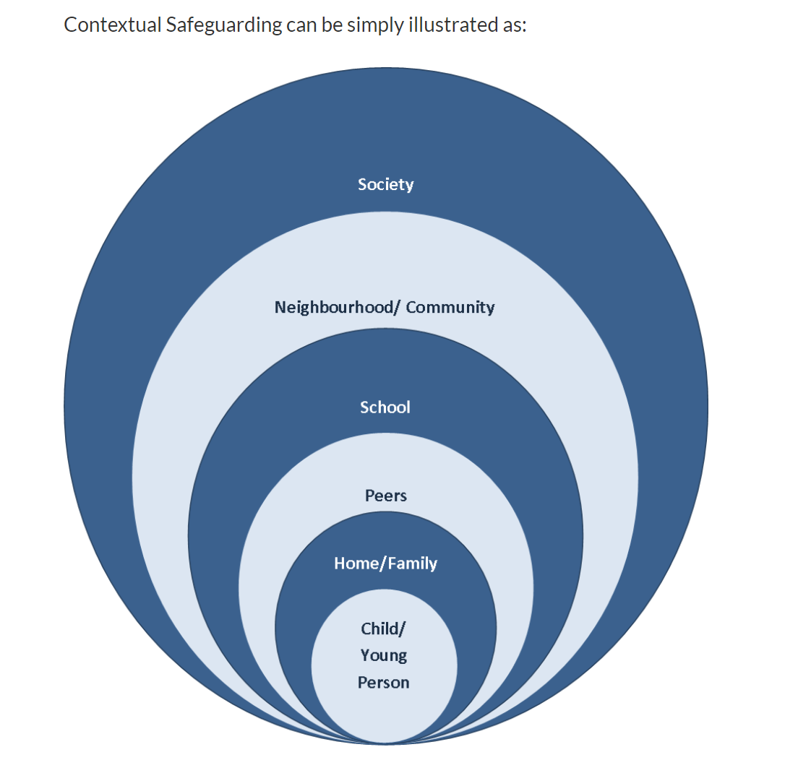
Contextual Safeguarding

Slide 17
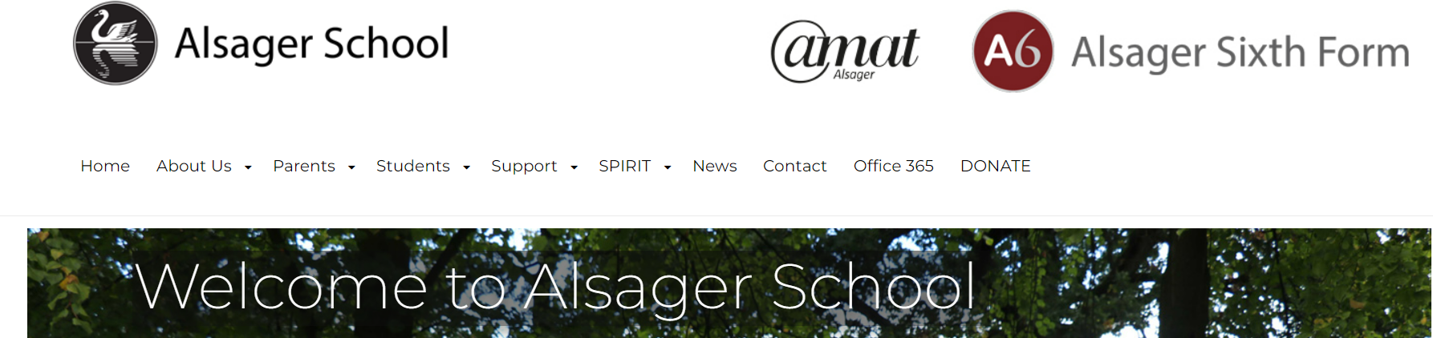
Parents in Partnership
To make a donation, follow the instructions under DONATE, which is on our website mainpage

Slide 18
Meet your Head of College
Tuesday 25th June
Dod - Mr Woods (Hall)
Lovell – Mrs Richardson (PE3)

Slide 19
Meet your Head of College
Monday 24th June
Royce - Miss Monaghan (Hall)
Moreton - Mrs Broad (PE3)

