Slide 1
Supporting my Child with their Learning.

Slide 2
Curriculum: the what, when and how of teaching.
Tuesday, 04 October 2022

Slide 3
Our Curriculum..
English
Maths
Science
Geography
RE
History
Modern Foreign Language
Computing and ICT
Design and Technology
Art
Music
Drama
PE
SPIRIT
SPIRIT lessons – our PSHE "plus" curriculum
SPIRIT enrichment – clubs after school and at lunch time – opportunities to participate
SPIRT in BfL - "you demonstrate your capacity to be resilient and embrace change"
Student code of conduct
Cross curricular
BfL program

Slide 4
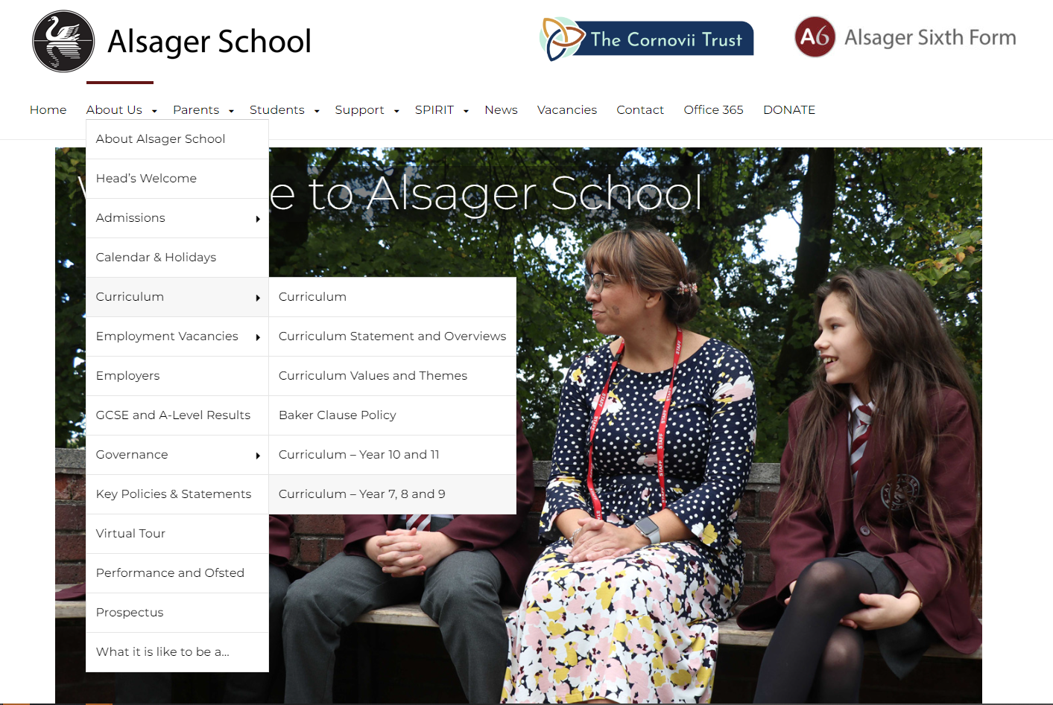
NEW!
Half termly information for parents is available on the website, so that you can get a flavour of what your child is learning.
About us>>
Curriculum>>
Curriculum Year 7,8 and 9.

Slide 6
Parent engagement:
"parent practices that establish a positive learning environment at home" make a difference to student learning and achievement. (Harris et al, 2009)
Parental engagement has a positive impact on average of 4 months’ additional progress. (EEF, 2021)
Make a calm space and time for homework.
Ask about homework, encourage use of examples in books and online resources to help.
Start a conversation about school, show that you value how well they are doing and what they are learning.
Find the positives! What went well today? What was the best bit? What made you laugh today?
Work with us: let us know if there are big changes to home situations. Talk to us if you have concerns. Remember that we all want your child to be happy and successful.

Slide 7
Assessment, Reporting and Behaviour for Learning (BFL) How is my child doing?
Tuesday, 04 October 2022

Slide 8
How do I know what is going on?
Daily – Insight (parent portal)
Daily – Planner
Termly – Assessment Points (AP) AP1 7/12/22 AP2 22/03/23 AP3 05/07/23
Parents’ Evening with subject teachers 30/03/23
Whenever you like – phone or email us
*Year 07 AP1 is a ‘Settling in Report’ (BFL grades and attendance)

Slide 9
Insight

Slide 10
Insight

Slide 11
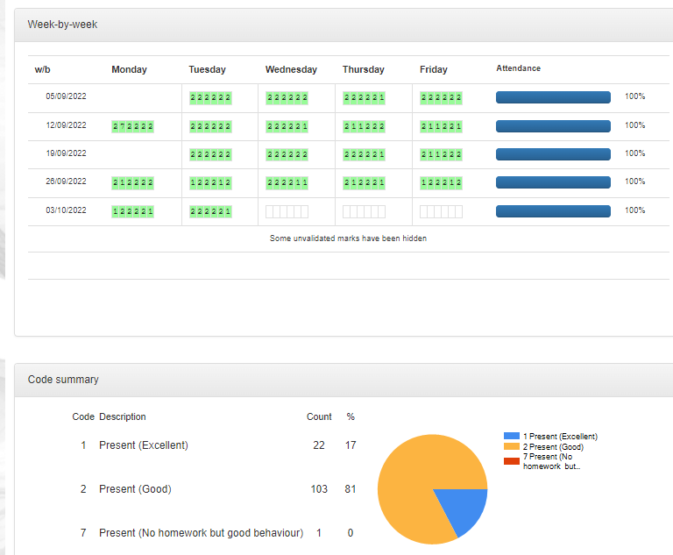
Insight

Slide 12
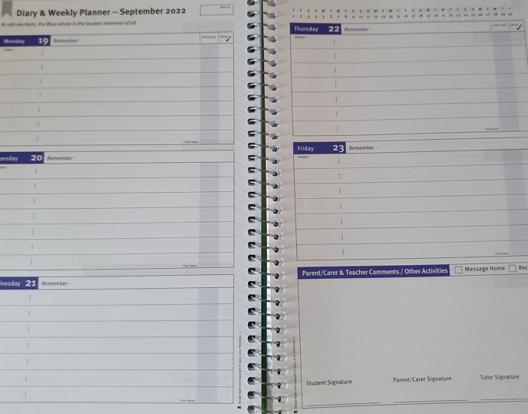
Student Planner

Slide 13
Assessment Point (AP) Reports
AP1 7/12/22 AP2 22/03/23 AP3 05/07/23 Information about:
Attendance.
Behaviour for learning (BFL) grades.
Advice on how to improve.
Current assessment grades.

Slide 14
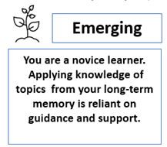
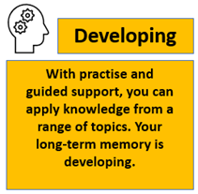
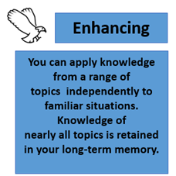
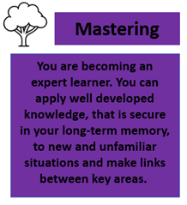
KS3 Assessment Points (AP)
KNOWING MORE AND REMEMBERING MORE
of what I have been taught!

Slide 15
 | Cumulative count to: |  |  | Cumulative count to:
BFL Grade | AP2 | AP1 | BFL Grade | AP2 | AP1
Excellent Standard (1) | 64 | 15 | Serious Cause for Concern (4) | 5 | 0
Expected Standard (2) | 594 | 221 | Issue with Homework (7) | 1 | 0
Below Expected Standard (3) | 1 | 0 | Missing Equipment (9) | 0 | 0
Subject | BFL | How to Improve | Assessment Grade at AP2
English | Expected | Aim to include examples of figurative language in your descriptions and stories. Complete worksheet I (Similes and Metaphors) on Teams, then write a description of a storm using metaphors and similes. | Enhancing
Maths | Excellent | To improve your understanding of the impact of rounding in increasingly complex calculations and how to apply it appropriately watch Mathswatch video N45b and complete the included worksheets at the end of the video. | Mastering
Science | Below Expected | You have experienced the 'Adventures of Little Francis' topic. To improve use the websites below to- Recognise that gametes are adapted to their function, explain the functions of the main reproductive organs and why a pregnant woman must avoid some substances, recognise the reasons behind using IVF, the importance of the maternal lifestyle during pregnancy, and how knowledge of the results of having sex is important in making lifestyle choices. KS3 BBC Bitesize / Biology / Reproduction: KS3 BBC Bitesize / | Emerging
Baseline Standard
English | Enhancing
Maths | Securing
Attendance at AP2: 97.2%

Slide 16
Reading
The academic challenges faced by students moving from primary to secondary education are often underestimated.

Slide 17
Your child must adjust to being taught by a range of teachers using a range of new types of texts, which are often dense and more technical than those encountered in primary school.
Such challenges can create a ‘literacy gap’, meaning that nationally many students making the transition from primary struggle to access the secondary school curriculum.

Slide 18
Reading Fluency
We need to work together to ensure fluent reading of increasingly difficult texts from Year 7-11.
97% accuracy is required for independent reading. Anything below 90% is at frustration level.
This becomes all the more challenging as motivation for reading declines in adolescence, making them less likely to want to read.

Slide 20
‘Nationally, children perform 10-30% worse on arithmetic word problems than on comparable problems based in numeric format’
‘The Language Factor in Mathematics Tests’, Abedi and Lord (2001)

Slide 21
The impact of poor reading
Academic achievement
Impact on qualifications and careers
Mental Health

Slide 22
How can you support your child at home?
Establish/continue regular reading routines (without it seeming like a chore).
Read and discuss reading with friends and family.
Encourage your child to read widely e.g. fiction and non-fiction, including articles.
Read ‘orbit’ texts to develop their knowledge and understanding of a topic.
Read aloud to them, or listen to an audio book together, so that they can regularly hear fluent reading of a variety of texts.
Ask your child lots of questions about what they’re reading.
Ask them to summarise what they have read and make predictions about what might happen.

Slide 23
The more parents are engaged in the education of their children, the more likely their children are to succeed in the education system. Research consistently shows that parental engagement is one of the key factors in securing higher student achievement.

