Slide 1
Welcome back
March 2020
September 2022
“Our children are counting on us to provide two things: consistency and structure.”
(Barbara Coloroso)

Slide 2
Our Vision:
To create an inclusive environment where all are empowered to thrive, hold themselves accountable and achieve. Our ethos of kindness is lived and not just talked.

Slide 4
What do we stand for?
Alsager School Strategy Statement
Alsager School is an inclusive comprehensive school, which serves a wide community. We serve every pupil from every background.
We will provide our pupils with the best possible tool kit: a world class education embracing deep knowledge and skill.
Staff at Alsager School take pride in their work; they share the moral duty to carrying out this strategy.
All staff at Alsager School are committed to fulfilling this promise. They strive for the best for our pupils. They are proud to work at Alsager School.

Slide 5
Alsager School Strategy Statement
We are committed to ensuring that the children of our community succeed. We understand the importance of improving life chances through academic success and the importance of becoming responsible citizens. This is reflected in our mission statement: ‘An Achieving School, A Caring Community.’
An Achieving School: Unlocking potential is our duty.
A Caring Community: We are here to make a difference.
The Alsager Curriculum
Our Unique Curriculum
Curriculum Implementation
Delivery of the Curriculum
Reading
SPIRIT – values and enrichment
Alsager Culture: High standards, High expectations

Slide 6
PRIORITIES
1. Implementation and delivery of the curriculum
2. Embedding assessment at KS3 and reviewing assessment practices at KS4/5
3. Reading

Slide 7
Return to The Alsager Way
The Alsager Way
We are kind and respectful to one another.
We have high expectations of all staff and pupils.
We demonstrate these with visible consistency and firm but fair application of the rules.

Slide 8
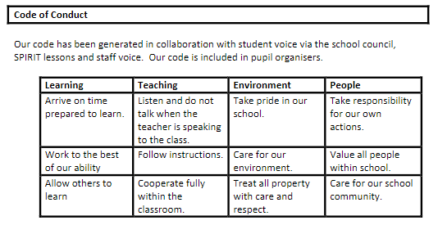
Code of Conduct

Slide 9
Conduct Card
Signatures
Acts of Kindness
Breaching standards (uniform, language, chewing gum etc.)
Going to the toilet in lesson time
Going to the toilet in lesson time should be the exception rather than the norm and pupils will be encouraged to wait until the end of the lesson. If they are unable to do so the teacher will sign the card and if this is a regular occurrence we will contact home.
Notes:
Guidance document to be circulated.

Slide 10
School Uniform This is the Alsager Way
‘Visible certainty amongst staff and students to allow exceptional behaviour to flourish’
Alsager School standards for all students:
Hair for boys and girls – no lower than a grade 2
One natural hair colour
No make-up or nail varnish/fake nails
Piercings – one stud earring in the lower lobe only
Skirt length just above the knee

Slide 12
“You cannot simply uncritically parrot the views of a few kids who misbehave, an activist or two, and try to imply there’s some kind of national scandal here. I’ve been in over 650 schools. In exactly none of them are kids taken anywhere more sinister than a supervised classroom.”
(Tom Bennett, OBE)

Slide 13
Sanctions
For the majority, the certainty of the sanction is a greater deterrent than its severity.
BFL 3 or 4
Conversation with the teacher after lesson
Detention
Phone call or email home

Slide 14
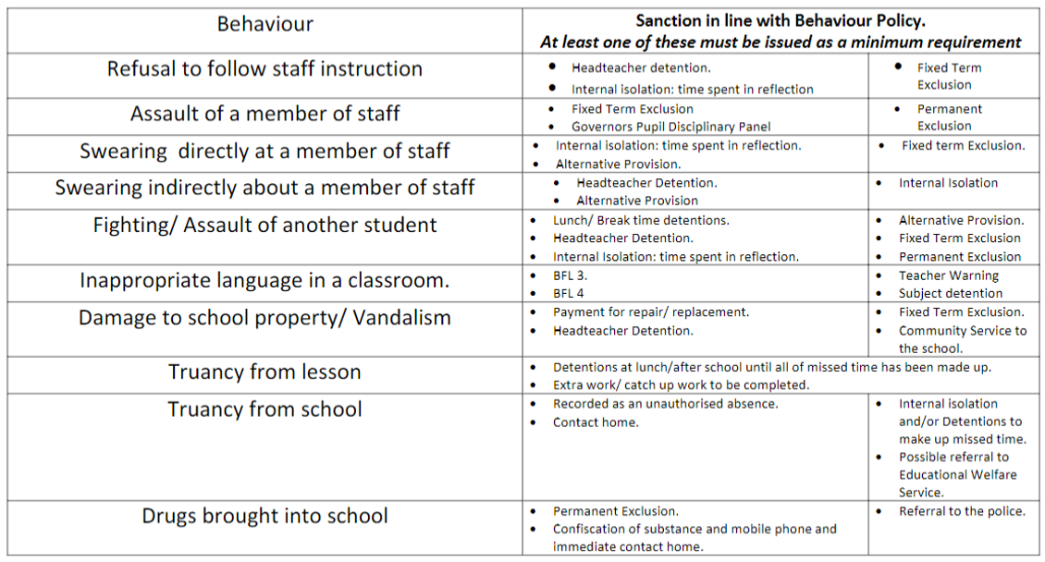
Sanctions for Serious Misbehaviour

Slide 15
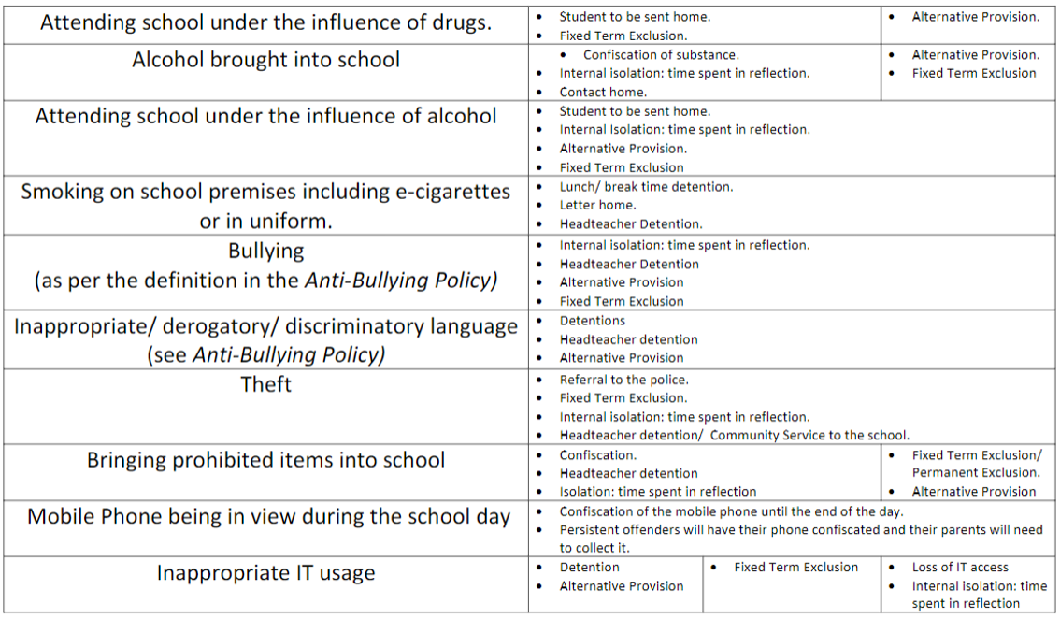
Sanctions for Serious Misbehaviour

Slide 16
Rewarding good behaviour
Faculty Level
Verbal praise,
Post card home,
Email home,
Phone call home,
Subject star nomination
College Level
100% positive grades = certificate home (Half termly)
Prize Draw
Extended lunch
Bronze, Silver, Gold Swans to pupils with the best Behaviour For Learning (Termly).

Slide 17
Curriculum
English Language
English Literature
Maths
Science
Geography
RE
History (including the history of the Arts)
Modern Foreign Language
Computing and ICT
PE
2 option choices.
Knowledge Rich
Our curriculum is knowledge focused, you may hear this language at home, “I know that…” or “I know how to…”
Options/Choices
The core curriculum (highlighted in burgundy) remains broad and balanced and all pupils also continue to study the history of the arts in Year 9.
NEW!
Half termly information for parents will be available on the website, so that you can get a flavour of what your child is learning.

Slide 18
Curriculum
Geography
History
Option 1
Information about Options will be sent out on 29th March. Students choose 3 from: Geography, History, and their two option subjects. These are the subjects they will continue into years 10 and 11, alongside the core curriculum.
Option 2
1. | 2. | 3.
*Most students will continue with a language – we hope all students will want to- some students will be offered an alternative.

Slide 19
Assessment
We use assessment to judge what your child knows and remembers from the taught curriculum.
Assessment will include dozens of flexible formative assessments, such as ‘frown of puzzlement’ and questioning, alongside more structured formative and summative assessments.
Teaching is responsive to the needs of your child.
Assessment is used to judge the extent of your child’s learning of the material in the course, for the purpose of measuring progress and to evaluate the effectiveness of our curriculum e.g. Have students remembered the core knowledge that will be used again and again? Have they been taught knowledge well in the short term to enable long term retention of key concepts? Do they have the knowledge that they should remember in later life?

Slide 20
Assessment Point Dates
Year 09
AP1 – 16/11/22
AP2 – 08/03/23
AP3 – 28/06/23
Parents’ Evening – 12/01/2023
All reports are available for viewing on our parent portal (Insight)

Slide 21
Reporting Home
Overall school attendance.
Total count of behaviour for learning (BFL) grades.
Baseline assessment grades for English and maths.
BFL grades for each subject.
Advice on how to improve.
Current assessment mastery grades.
Lesson attendance.

Slide 22
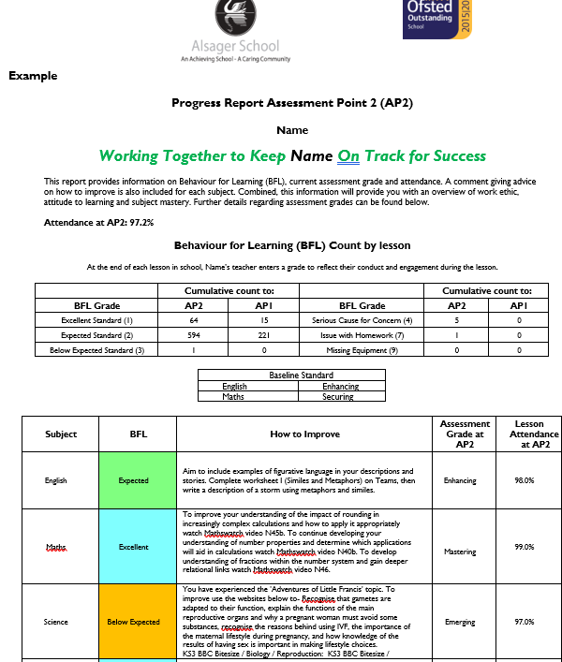

Slide 23
Parent Portal - Insight – Online and App
Download the APP onto your phone.
Enter your Insight username and password.
It will ask for the barcode which you can get from the Insight page on the school website

Slide 24
What is the significance of the following number?
1,483,300
Notes:
Young children who are read to every day from birth to the start of reception will have heard about 1.4 million more words than children who were never read to. This means children who benefit from being read to are already so much more prepared in Year 1, 3, 6 and 7 when they get to us.

Slide 25
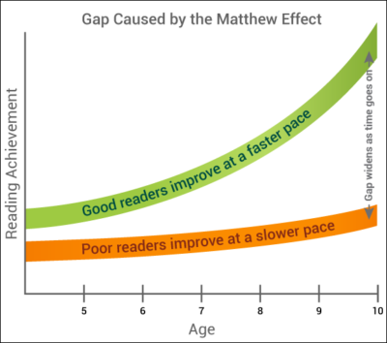
Notes:
The Matthew Effect refers to a pattern in which those who begin with advantage accumulate more advantage over time and those who begin with disadvantage become more disadvantaged over time. Essentially success breeds success or the rich get richer.

Slide 27
‘Nationally, children perform 10-30% worse on arithmetic word problems than on comparable problems based in numeric format’
‘The Language Factor in Mathematics Tests’, Abedi and Lord (2001)

Slide 28
Reading Strategy 2022-23
KNOWLEDGE AND STRATEGY = SKILLED READING

Slide 29
KNOWLEDGE AND STRATEGY = SKILLED READING
Knowledge = Curriculum
Effective Sequencing
Disciplinary literacy
Expanding Tier 2 and 3 language
Notes:
Effective sequencing – does the cu

Slide 30
KNOWLEDGE AND STRATEGY = SKILLED READING
Strategy
Assessment of reading
Interventions for weakest 20%
Fluency Development
Explicit teaching of reading strategies

Slide 31
Lower literacy levels = poorer academic performance and wider life chances
Lower self-esteem
Less likely to stay in education
Negative impact on behaviour
More difficulty making friends
Worse school attendance rates
Greater difficulty getting work after leaving school

Slide 32
How can you support your child at home?
Establish/continue regular reading routines.
Encourage your child to read widely e.g. fiction and non-fiction.
Ask your child lots of questions about what they’re reading.
Ask them to summarise what they have read and make predictions about what might happen.
Read and discuss reading with friends and family.
Maintain the motivation to read.

Slide 33
Alsager School: Reading Rubric
 | 1 | 2 | 3 | 4
Expression and Volume | Reads with little expression or enthusiasm in voice. Reads words as if simply to get them out. Little sense of trying to make text sound like natural language. Tends to read in a quiet voice. | Some expression. Begins to use voice to make text sound like natural language in some areas of the text, but not others. Focus remains largely on saying the words. Still reads in a quiet voice. | Sounds like natural language throughout the better part of the passage. Occasionally slips into expressionless reading. Voice volume is generally appropriate throughout the text. | Reads with good expression and enthusiasm throughout the text. Sounds like natural language. The reader is able to vary expression and volume to match his/her interpretation of the passage.
Phrasing | Monotonic with little sense of phrase boundaries, frequent word-by-word reading. | Frequent two- and three-word phrases giving the impression of choppy reading; improper stress and intonation that fail to mark ends of sentences and clauses. | Mixture of run-ons, mid-sentence pauses for breath, and possibly some choppiness; reasonable stress/intonation. | Generally well phrased, mostly in clause and sentence units, with adequate attention to expression.
Smoothness | Frequent extended pauses, hesitations, false starts, sound-outs, repetitions, and/or multiple attempts. | Several “rough spots” in text where extended pauses, hesitations, etc., are more frequent and disruptive. | Occasional breaks in smoothness caused by difficulties with specific words and/or structures. | Generally smooth reading with some breaks, but word and structure difficulties are resolved quickly, usually through self-correction.
Pace | Slow reading. | Moderately slow reading. | Uneven mixture of fast and slow reading. | Consistently conversational.

Slide 34
Enrichment Opportunities at Alsager School
Enrichment opportunities have been shown to improve pupil attainment as well as helping them to develop friendships and the skills required for life outside the classroom.
Alsager School has a wide range of enrichment clubs for all pupils and opportunities to participate in intercollege competitions throughout the year.
All Year 9 students will debate current affairs in form time. There are further opportunities to participate in external competitions.

Slide 35
Intercollege sport
Knitting club
First aid club
Gardening
Debating
Cooking
Textiles
Science club
Cross country
Badminton
Football
Any many more…
These will be advertised around school, in forms, online and during an enrichment fair. Your child will have the opportunity to get involved with as many activities as they wish.

Slide 36
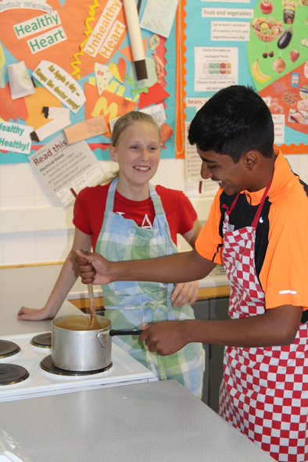
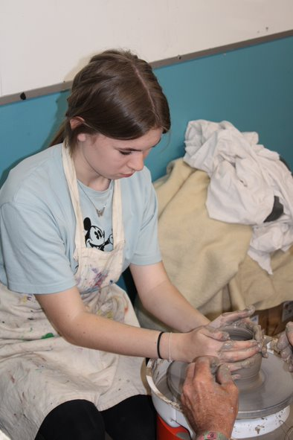
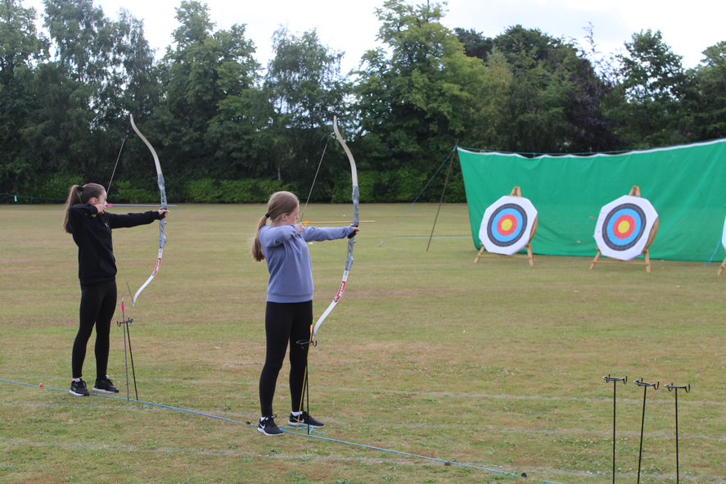
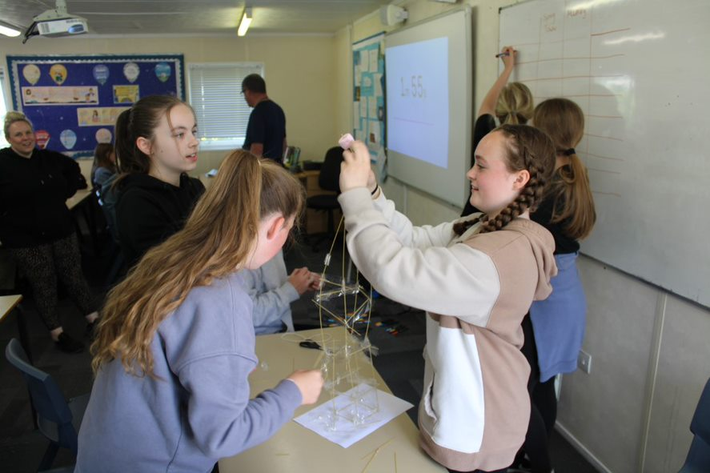
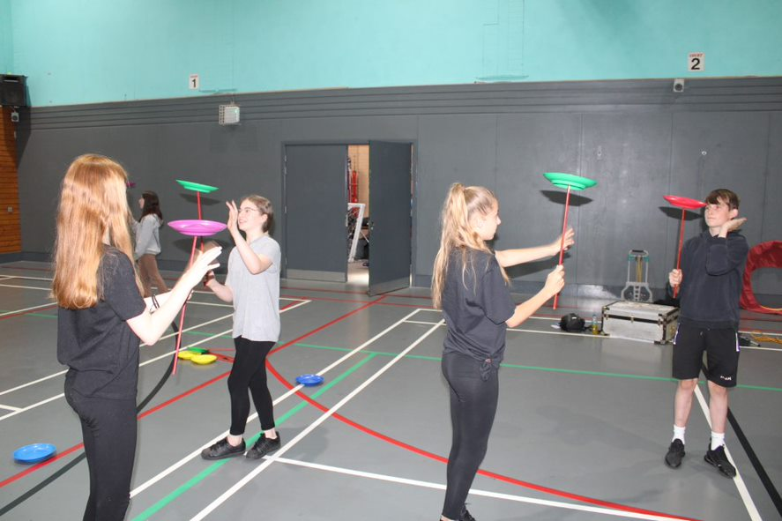
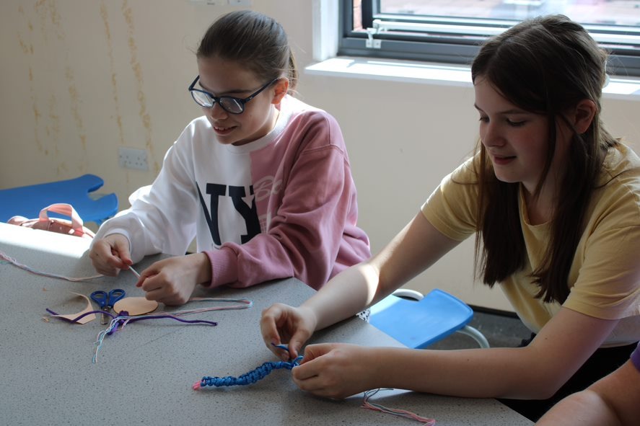
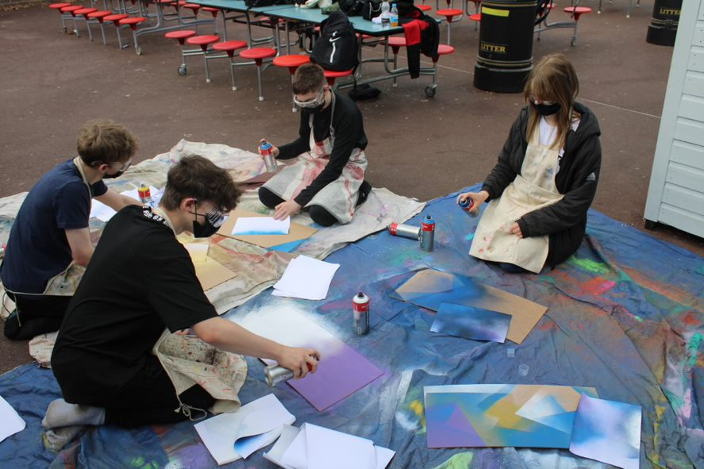
SPIRIT Week 2022

Slide 37
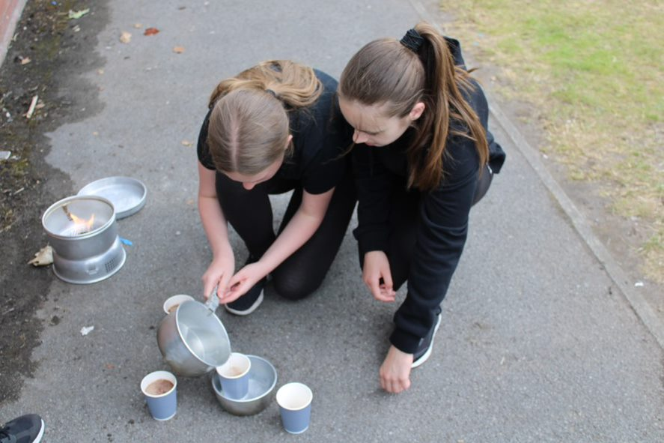
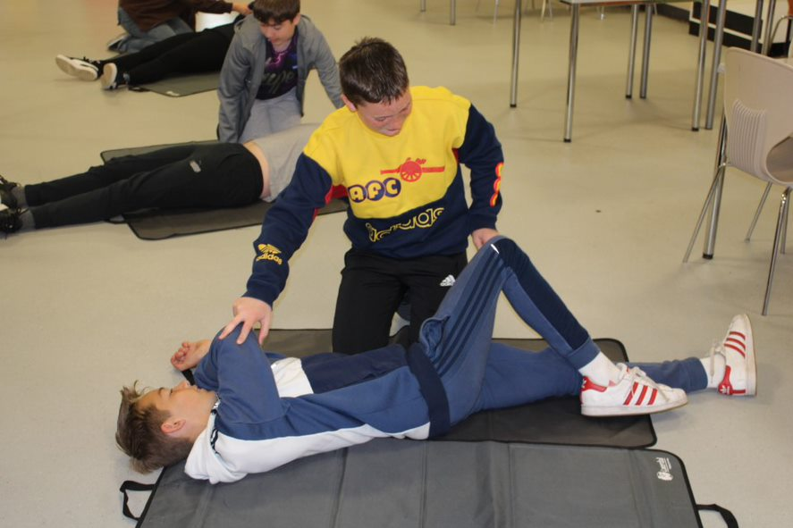
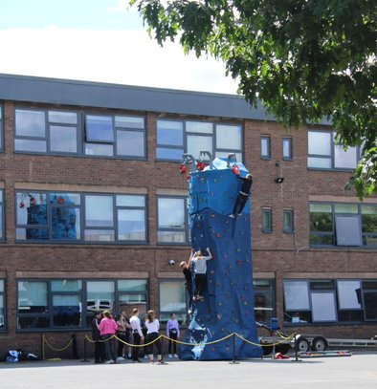
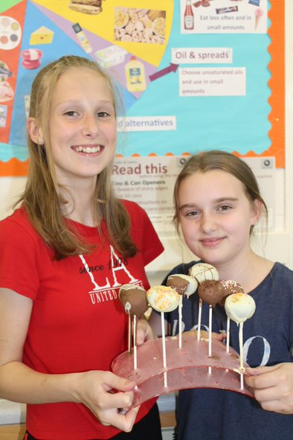
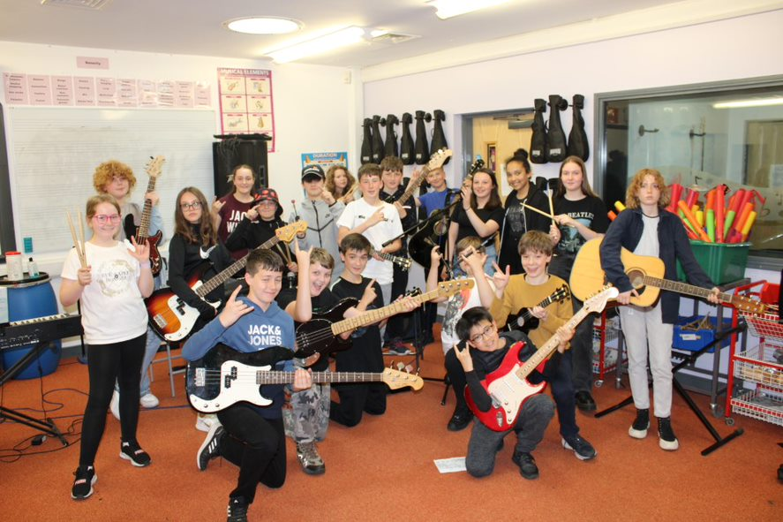
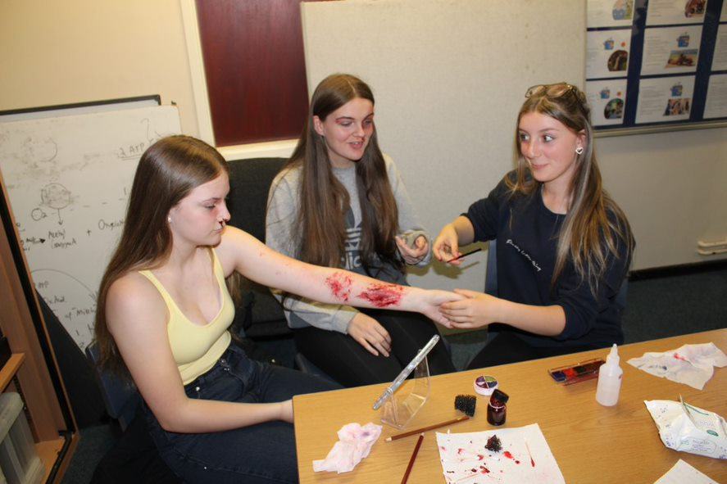
SPIRIT Week 2022

Slide 38
Contextual Safeguarding
Parental influence
Peer influence
Safeguarding concerns around Alsager
Parenting

Slide 39
Key contacts
Head of Dod: t.woods@alsagerschool.org
Head of Lovell: g.potts@alsagerschool.org
Head of Moreton: j.broad@alsagerschool.org
Head of Royce: v.monaghan@alsagerschool.org
Absence: absence@alsagerschool.org
General: admin@alsagerschool.org

