Slide 1
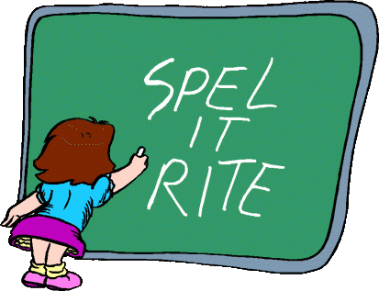
Spelling in year 7
Judith Barwick
Arlene Preston

Slide 2
Why are we doing this?
New Government legislation - there will be more marks awarded for spelling, punctuation and grammar.
Improve spelling in all areas across the school
Why year 7’s? New vocabulary on entering secondary school.

Slide 3
How are we going to do this?
One session each week will be dedicated to spelling with their form tutor
Key stage 3 subject specific words
2 different sets of spellings
Higher ability (group A) 5 spellings per week
Lower ability (group B) 5 spellings per week
5 Spellings

Slide 4
Do all children need spelling?
Yes – new vocabulary
Can be used for their modern foreign language
We all have words that we misspell
Gain higher marks for the use of more sophisticated vocabulary

Slide 5
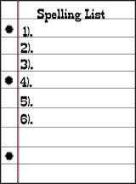
Weekly spellings example
Group A (higher ability)
Group B (lower ability)
subtraction
percentage
symmetry
rotation
multiplication
addition
amount
litre
minus
square

Slide 6
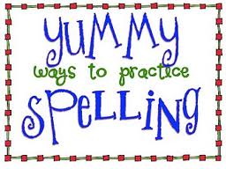
Ways to learn spellings
Look, cover write & check
Find words within the word (there's a 'hen' in 'when'!)
Break the word up into smaller parts (Wed + nes + day = Wednesday)
Break the word up into sounds (th-a-nk)
Make up a silly sentence using the letters (big elephants cause accidents under small elephants spells 'because') - mnemonics
Spelling rules
Simultaneous Oral Spelling

Slide 7
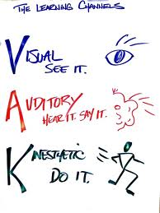
Simultaneous Oral Spelling (SOS)
Why use SOS?
It accommodates all learners (visual, auditory & kinethestic)
Pupils already doing SOS in year 8 and their spelling continues to improve

Slide 8
The method to use is as follows:
Write the target word (visual)
Tell your child what the word is (auditory)
Ask your child to repeat the word (they can feel their speech organs) (kinesthetic)
Ask your child, “What the letters/sounds that makes up the word?” (Some children will use the letter names, whereas others will feel more confident if they use the letter sounds. However, they should not mix the two.)

Slide 9
Ask your child to write the word, saying the letter name/sounds and maybe blends, as they write it. (visual, auditory & kinesthetic)
Once your child has finished writing the word, ask them, “What is the word?”
Check the word has been written correctly and ask your child to check also.
If an error has been made, then ask your child to look at each letter individually, starting with first letter. Once they see where the error has been made, then ask them to write it again, in the same box, but ensure that they still say the letter name or sound as they write it.

Slide 10
Repeat steps 3 to 8 again, until they have written the word correctly 5 times
Ask your child to look at the word again and ask them “what is the word?”
Ask the student “What are the letters that make up the word?”
Get your child to either, fold over the sheet so that they cannot see the word, or cover it over
Get your child to write the word again, ensuring that they say the letters/ sounds as they write it
Check with your child, that the word is written correctly

Slide 11
Final steps
Move onto the next word following the same steps
This should continue for 4/5 days
Each week a spelling test will take place
All pupils will be shown this method in form
Any Questions ?

