Slide 1
Mindfulness

Slide 2
Definition of mindfulness
Mindfulness means paying attention in a particular way: on purpose, in the present – moment, and non-judgementally.
Mindfulness is the practice of making ourselves more aware of thoughts, feelings and behaviour and is a necessary life-skill for fostering happiness and wellbeing.
Mindfulness is also about pushing away intrusive thoughts, learning to “pause” before reacting, and paying attention to each of your senses. It is a branch of positive psychology.

Slide 3
Benefits of mindfulness
Better concentration, calmness, less reactive, less worry and better abilities to cope with stresses and anxieties.

Slide 4
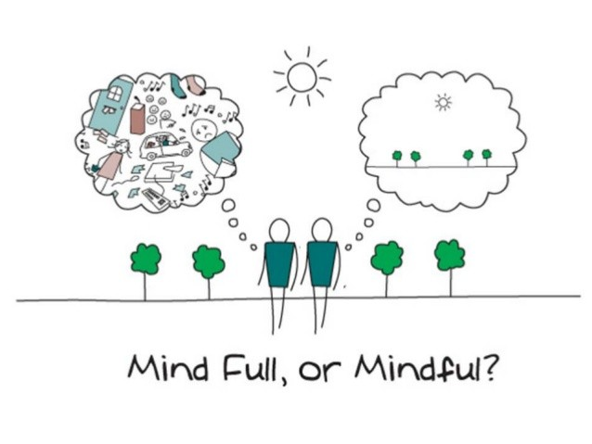

Slide 5
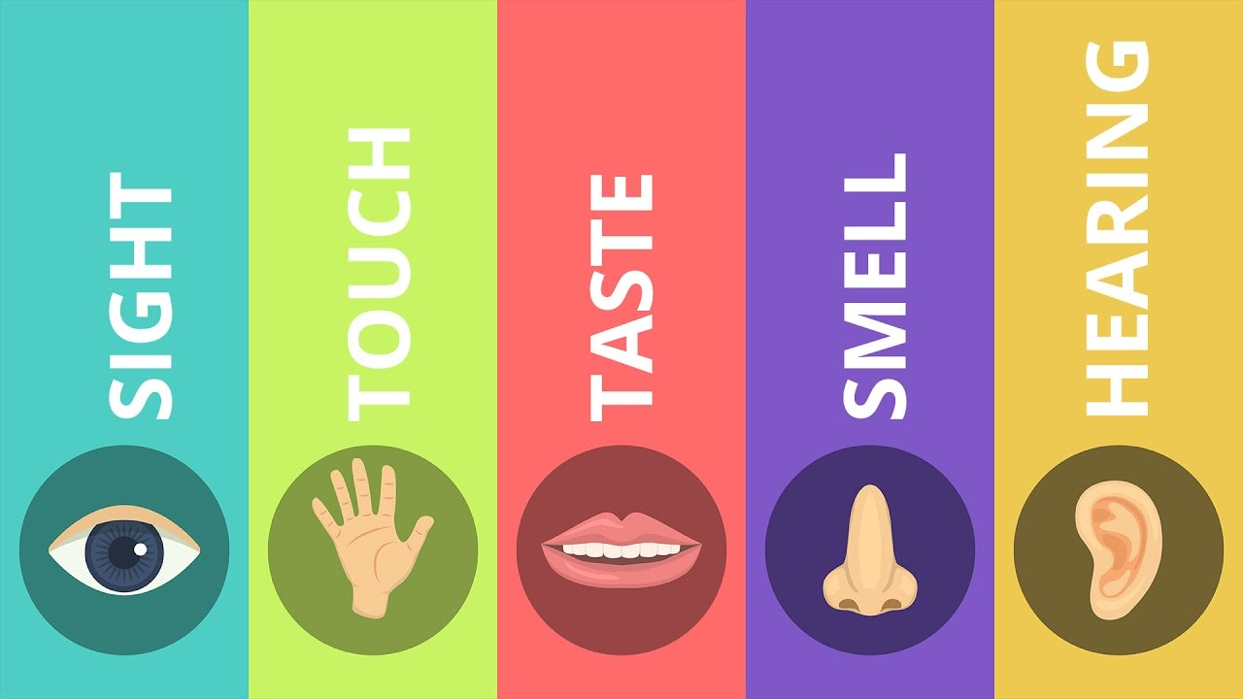
TURN ON YOUR SENSES
What flavours does it taste of? Do they change?
What did you hear as you opened or ate it?
What texture does it have?
What did you enjoy about eating this?
Did you notice your mind wandering?

Slide 6
Calm breathing

Slide 7
visualisation

Slide 8
recommendations
Books
“How to be Human” and “Frazzled” by Ruby Wax
“Little Book of Mindfulness” by Patrizia Collard
Apps
Headspace
Calm

