Slide 1
Dod College

Slide 2
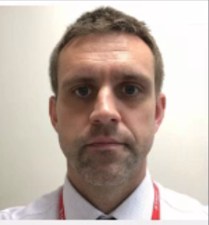
Introductions
Rob Pearce
Senior Leadership Link
Mr Woods
Head of College

Slide 3
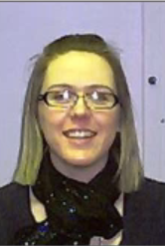
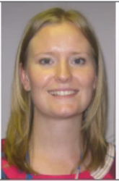
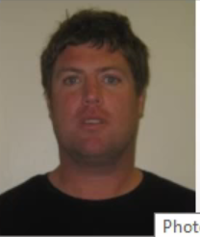
Year 7 Form Tutors
Mrs Carney-Cox
Miss Wise
Mr Morris

Slide 4
Dod College
Named after Lottie Dod.
5 times Wimbledon Champion
British Ladies Am. Golf Champion
Olympic Silver Medallist
Represented England in Hockey
College Colour is Red.
Teenage Cancer trust

Slide 5
What it Means to be Dod
Kindness and Respect
There’s no such thing as “can’t”
No fear of failure
Don’t accept less than your best

Slide 6
Alsager School Website

Slide 7
Dod College
14:86

Slide 8
Uniform guidance/ expectations
Outdoor coats should be waterproof and are only permitted outdoors.
Standards cards.
Piercings – one small stud in each ear lobe.
NO NOSE STUDS/RINGS/CHAINS
No jewellery/ bracelets or rings – with the exception of wrist watch and one charity band.
Hair colour should be natural.
Extreme hairstyles are not permitted, including shaved designs.

Slide 9
Uniform guidance/ expectations
a LOGO is a NO GO
The following items are not permitted under any circumstances;
Canvas shoes/pumps or logoed shoes/trainers. The school has the final decision over the suitability of footwear.

Slide 10
Technology
Valuables remain the responsibility of the student. Alsager School accepts no responsibility for any loss or damage.
Mobile phones !
Mobiles or smart watches are not to be used on the school site during the day.
All contact with your child during the school day should be made via the school.

Slide 11
How can I help my Child?
Check your child’s organiser daily.
Please sign it weekly.
Encourage your child to pack their bag the night before.
Make sure they have all their equipment.
Make sure they have a good breakfast.
Have a good look at the school’s web site.

Slide 12
Pupil Attendance
Holidays in term time
Department for Education Regulations from September 2013
Parents should not take students on holiday during term time.
A request for holiday absence should be addressed to the Headteacher and should only be for exceptional circumstances
The Headteacher makes the decision whether the request will be authorised or not
A full version of Alsager School’s Attendance Policy is available to view on the schools website, www.alsagerschool.org

Slide 13
Behaviour for Learning
BFL is a system designed to encourage our students to behave in a manner which enables learning.
There are a number of rewards and celebrations for students who achieve 2s and 1s in their lessons.
We want to celebrate this excellent behaviour as we know it impacts positively on learning
There are a number of BFL grades
1 & 2 these are the ones you want to see
3 & 4 not the ones you want to see
8 for late
6,7,9 mean something very different

Slide 14
Dod Prefects;
Simply the Best!

Slide 15
Dod College
Kindness and Respect

