Slide 1

Year 8 Options
2024

Slide 2
The Future
“ The only thing certain about the
future is that it will be uncertain”
Half the jobs your children will be doing in 2034 don’t exist yet.
Employers and Universities also want skills and personal qualities

Slide 3
Why choose in Year 8?
Our curriculum for our students…
Our Year 7 and 8 curriculum is rich in knowledge, so we are able to offer some choice in year 9.
Time to study subjects thoroughly – not just the specification
Allow students to develop thirst for learning beyond confines of exams.
All students continue to study broad range of Core subjects.
Notes:
Talk about our students, what we want for our young people beyon this and lead into the Ebacc.

Slide 4
What will I study Next Year?
Core Curriculum:
This is what everyone must do. All students study the core curriculum.
2 Option Subjects:
These are your choices. You can choose 2 option subjects.
Year 9 Curriculum

Slide 5
Year 9 “Core” Curriculum?
Core Curriculum – everyone studies these subjects.
All students will study English Language and English Literature
English Language
English Literature
Maths
Science
RE
History
Geography
MFL
PE
IT/Computing
SPIRIT Learning
All students will study the Maths GCSE course
All Students will study Science.
All students will study the RE course. Students will take at GCSE at the end of Year 10
Almost all students will study a Modern Foreign Language until the end of Year 11. Some will be offered alternate choices to consider for Years 10 and 11.
All students will have further choices to make at the end of year 9 (all students will choose either Geography or History, some will choose both)

Slide 6
What choice do I get this year?
Two options subjects.
Art
Business Studies
Child Development
Computer Science
Dance
D&T Graphic Products
D&T Resistant Materials
D&T Fashion and Textiles
Drama
Engineering
Food & Nutrition
Music
PE
Dual linguists may choose a 2nd Modern Foreign Language
Notes:
List subject to change – I’ve only had comms faculty preferences so far!

Slide 7
What choice do I get next year?
Geography
History
Option 1
Option 2
1. | 2. | 3.
*Most students will continue with a language – we hope all students will want to- but there will be alternatives, and some students will have an additional choice to make (by invitation).

Slide 8

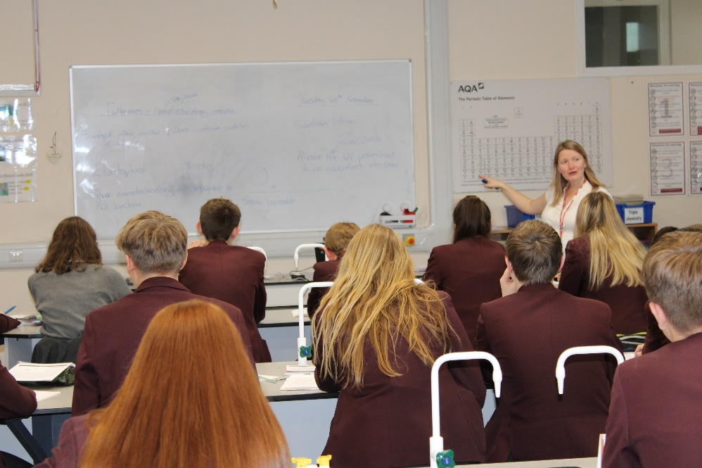
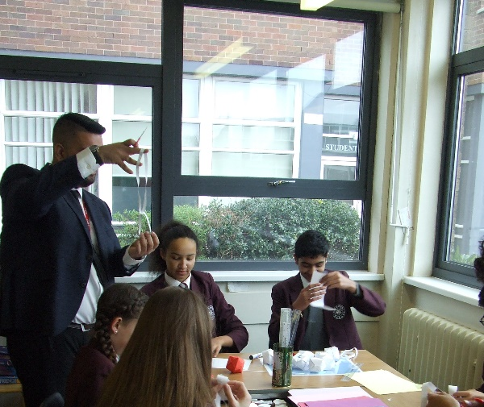
By invitation (years 10 and 11):
A small number of pupils will be offered an alternate to languages, this includes core enrichment, which enables students to develop social and employability skills.
Triple Science will be taught to some pupils in Science lessons.
Further Maths will be taught to a very small number of student in their maths lessons.

Slide 9
Options – how should students choose?
Do they enjoy the subject?
What is the subject about?
What pathways and courses are there?
What do they want to do in the future?

Slide 10

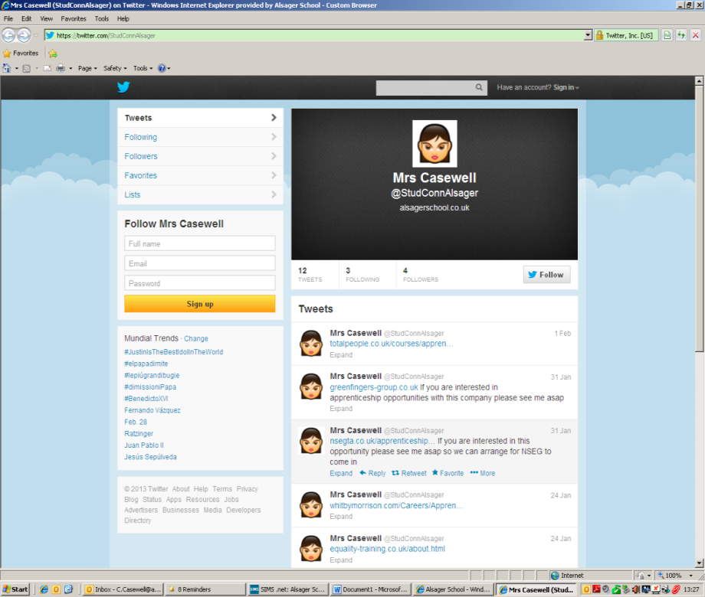

Inspired Futures – Help is available
Permanently staffed
Careers Service
START website
Form Tutors

Slide 11

Website

Slide 12
What happens next?
Year 8 Parents Evening– Thursday 15th Feb
Electronic form sent to parents – Friday 15th March
Options returned to tutors – Wed 20th March
Option Choices confirmed with students and parents in summer term

Slide 13
Year 8 Options
2024

