Slide 1

THEME1 INVESTIGATING A SMALL BUSINESS
ENTREPRENEURS: Who are they?
What common characteristics do they have?
1. Why do new ideas come about?
*
*
*
How?
*
*
It could depend on ….
SHORT TERM VS LONG TERM AIMS & OBJECTIVES
ECONOMY
AVAILABLE FINANCES
TECHNOLOGY
3.AIMS & OBJECTIVES
Financial Aims & objectives Non Financial Objectives
* *
* *
* *
* *
*
Why differ between businesses?
DYNAMIC
COMPETITION
LEGISLATION
STAKEHOLDERS
4. Why does Cash matter?
During start up?
During growth?
Why is cash important to a business?
How should cash be managed?
RISKS & REWARDS
* *
* *
* *
4. Forecast Revenue, Costs & Profit
6. Location
*
*
*
*
The nature of business activity & impact of e-commerce:
The role and importance of a Business plan:
4. Cashflow forecasts;
NCF
Closing Balance :
What does the Closing balance become?
How can a business improve its cashflow?
Role of Enterprise Role of Entrepreneurship
* To produce goods and service * Organise Business resources
* To Meet Customer needs * Make Decisions
*To add value: *Take Risk
.
.
.
.
.
Business Plan
Business Idea
Target Market
Aims & Objectives
Forecast revenues, Costs, Profit & cashflow
Sources of Finance
Location
Marketing Mix
4. Cashflow forecasts;
NCF
Closing Balance :
What does the Closing balance become?
How can a business improve its cashflow?
2.Market Segmentation
*
*
*
*
*
Benefit of market segmentation:
2. CUSTOMER NEEDS
Price
Quality
Choice
Convenience
Design
2.Primary Mkt research
Egs
Ads
Disads
2.Qualitative vs Quantitative data
5. Sources of Finance
Short –term methods of finance:
*
*
Long –term methods of finance:
*
*
*
*
*
*
2.Secondary Mk res
Egs
Ads
Disads
2.Importance of accuracy and reliability of data
2.Market Mapping
4.Break – even graph & Formula
Margin of safety:
2.Market research :
Purposes
*
*
*
*
2.Competition’s strengths & weakness and how to compete:

Slide 2
THEME1 INVESTIGATING A SMALL BUSINESS 2
Types of ownership start – up and small Business
(plcs are considered for theme 2 )
7. Marketing Mix
P
P
P
P
How do you balance the MM in a competitive environment?
What is the impact of changing consumer needs on the MM?
The impact of Technology on the MM?
Technology & Business
E Commerce
Social Media
Digital Communication
Payment Systems
How technology influences business activity:
Sales
Costs
Marketing Mix:
Business responses to changes in technology:
Sole trader
Unlimited liability
Benefit s
Disadvantages
Stakeholders & their objectives
*
*
*
*
*
*
*
*
How stakeholders are affected by business:
How stakeholders impact business activity
Possible conflict between stakeholder groups:
Partnership
Benefit s
Disadvantages
4& 5 Interest rate calculations:
Legislation:
Consumer
Employment legislation
Health & safety
Equality
The impact of legislation on Business:
Advantages
Disadvantages
Business responses to changes in legislation
Private limited company
Limited liability
Shareholder
Benefit s
Disadvantages
The Economic climate & Business
What is the impact on the business or customers of changes in :
Unemployment
Consumer Income
Inflation
Interest rates
Government taxation
Changes in Exchange rates
Business responses to changes in the economic climate:
Franchises
Advantages
Disadvantages

Slide 3
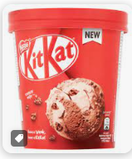
THEME2 BUILDING A BUSINESS 1
Changes in aims and objectives
Why business aims change – give examples of :
Market Conditions
Technology
Performance
Legislation
Internal Reasons
How business aims & objectives change:
Focus on survival or growth
Entering or exiting markets
Growing or reducing the workforce
Increasing or decreasing the product range
Impact of Globalisation
Over the past 50 years, international trading has become more common.
Impacts on UK Businesses:
Imports
Exports
Changing Business location
Multinationals
Barriers to International Trade
Tariffs
Trading blocs
How businesses compete internationally:
Internet & e-commerce
Changing the Marketing Mix
It could depend on ….
ECONOMY
OWNERSHIP
GLOBAL COMPETITION
FINANCIAL PERFORMANCE & DEBT
Growing a business is especially important when the market you are in is growing. Without growth, your firm becomes less significant and may struggle to maintain market share, especially if retailers no longer wish to sell your brand.
SHORT TERM VS LONG TERM AIMS & OBJECTIVES
TECHNOLOGY
LEGISLATION
STAKEHOLDERS
ETHICS
ENVIRONMENTAL CONCERNS
ECONOMIES OF SCALE
RELATIONSHIP WITH SUPPLIERS
INVESTMENT PRPOSALS
External ( organic growth )
Merger
Take over
Advantages
Disadvantages :
Understanding Business Performance
Give the use & limitations of each:
Line graphs, bar charts & Pie charts
Financial data
Marketing data
Market Data
Internal (organic growth)
Why is it the safest method?
How is it funded ?
For Kit-kat – give examples of :
New products:
Innovation
R&D
New markets :
Geographically
Using technology
Using MM
Challenges :
Ethics, the environment & Business
How do ethical considerations impact on business?
How do environmental considerations impact on business?
What is the impact of pressure group activity on business?
Financing Growth
Why is additional finance required to grow?
Internal Finance:
*
*
External Finance
Advantages Disadvantages
*Loan Capital
*Share Capital
*Become a plc
Financial Performance
£000s
Revenue 800
Less Cost of Goods Sold (500)
Equals GROSS PROFIT ?
Less Other Operating exps (100)
Equals NET PROFIT ?
GPM = GP x100 NPM= NP x100
Revenue Revenue
ARR = Average Annual Profit 100
Cost Of Investment

Slide 4
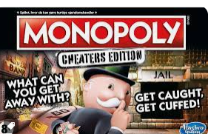
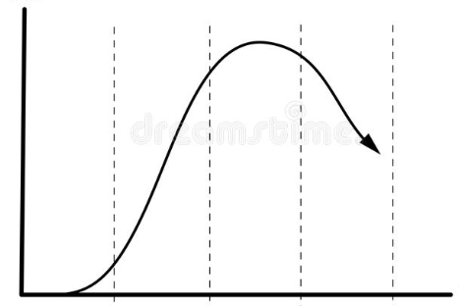
THEME2 BUILDING A BUSINESS 2
Making Marketing Decisions – The Marketing department create demand
PRICING STRATEGIES
How do the following influence prices?
Technology
Competition
Market Segments
Product Life Cycle
How will your price compare with your production volumes ?
What pricing strategies are you aware of?
How can changing the price affect volume?
How can changing eth price impact profit margin?
PLACE
What are the 3 main methods of distribution?
& what are the advantages & disadvantages of each method?
Ads & disads
Direct
Retailer
E-tailer
PRODUCT- needs to match TARGET MARKET so identify the priorities of target customers:
THE DESIGN MIX
Helps the business make decisions in what mix of the 3 priorities its target market expects to see from the product.
PRODUCT DIFFERENTIATION
How could you make your product seem different from rivals?
*
*
*
*
*
*
*
Will this help develop loyalty?
Will tis give you freedom over your price?
THE PRODUCT LIFE CYCLE
Label the axes & stages:
Why is the mature stage so important ?
Which extension strategies could help a business?
How has Monopoly used extension strategies & technology over time?
PRMOTION
How do these link to Market segmentation?
Advertising
Sponsorship
Branding
Product Trials
Special offers
How can technology be used in Promotion?
Targeted online
Viral social media advertising
E- newsletters
USING THE MARKETING MIX TO MAKE BUSINESS DECISIONS
What is the impact if of each P on the other p’s?
Product
Price
Promotion
Place
How can the Marketing Mix build competitive advantage & implement decisions?
Product
Price
Promotion
Place

Slide 5
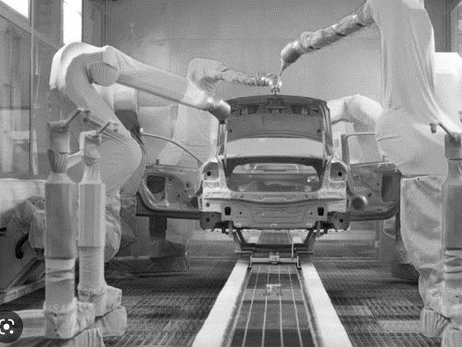
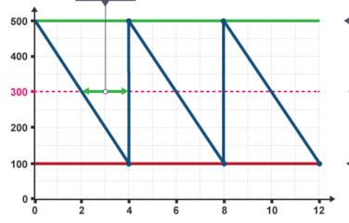
THEME2 BUILDING A BUSINESS 3
Making Operational Decisions
The operations part of the business is responsible for ensuring that customers produce and deliver the products or services customers want to buy.
WORKING WITH SUPPLIERS
What happens if businesses have :
Excessive stock?
Insufficient stock?
Label the bar stock graph:
SALES PROCESS
What are the 5 stages of the Sales Process?
*
*
*
*
*
Why is effective customer service so important to gain a competitive advantage and what is the risk of poor customer service?
PRODUCTION PROCESSES
Give examples & advantages & disadvantages of each :
JOB PRODUCTION
BATCH PRODUCTION
FLOW PRODUCTION
What impact does Technology have on ?
Production Costs
Productivity
Quality
Flexibility
How has Technology impacted production? Consider productivity, efficiency & economies of scale.
What is CAD & CAM?
Working with Suppliers
What is important for the relationship with suppliers and why?
*
*
*
*
*
LOGISTICS & PROCUREMENT
What is the impact of logistics on supply decisions?:
Costs
Reputation
Customer satisfaction
What is the impact of Procurement finding the right materials & supplies on:
Efficiency, Quality, Flexibility
Reliability, Cost & Trust
MANAGING QUALITY
What are the 2 methods of checking quality ?
What are the advantages & disadvantages of each ?
*
*
JIT
Describe what JIT is & how much buffer stock is held?
What are the advantages of JIT?
What are the disadvantages of JIT?
What is important for working with suppliers?

Slide 6



THEME2 BUILDING A BUSINESS 4
Making Human Resource Decisions
COMMUNICATION
Why is effective communication important for a business?
What are the consequences of insufficient communication?
What are the consequences of excessive communication?
What can be barriers to effective communication?
*
*
*
*
*
ORGANISATIONAL STRUCTURES
What are the two types of Organisational structure and advantages & disadvantages of each?
Ads & Disads
*
*
What are the two ways in which decisions can be made and what are their benefits & drawbacks?
Benefits & drawbacks
*
*
ROLES & RESPONSIBILITIRES
Rank these 3 types of roles from least to most responsibility :
Supervisor / team leader
Director
Operational and support staff
Senior Manager
Can you describe what sort of tasks they do / manage?
MOTIVATION
Having staff who want to work, want to do the best job possible and are committed to the success for the business can lead to:
Higher productivity
Attracting the best employees
Lower staff turnover
Lower recruitment costs
Better quality from production or service
More ideas from staff
TRAINING & DEVELOPMENT
Name the 4 types of training and when is each suitable?
*
*
*
*
Why is it important to train and develop employees ?
How can it help retain employees ?
Why should employees be set targets and have performance reviews?
Why is retraining needed to use new technology?
DIFFERENT WAYS OF WORKING
*
*
*
What is the difference between Permanent, temporary & freelance contracts?
What is the impact on technology on how we work?
Technology & efficiency
Technology & remote working
FINANCIAL METHODS OF MOTIVATION
*
*
*
*
NON FINANCIAL METHODS OF MOTIVATION
*
*
*
RECRUITMENT
What are the advantages & disadvantages of:
Internal Recruitment
External Recruitment
Name 5 documents used during the recruitment process :
* * *
*
Well motivated workers high productivity increased out put higher profits
Unhappy workers do not work effectively
low output lower / no profit

