Slide 1
A Quick Guide to KS3 Reports

Slide 2
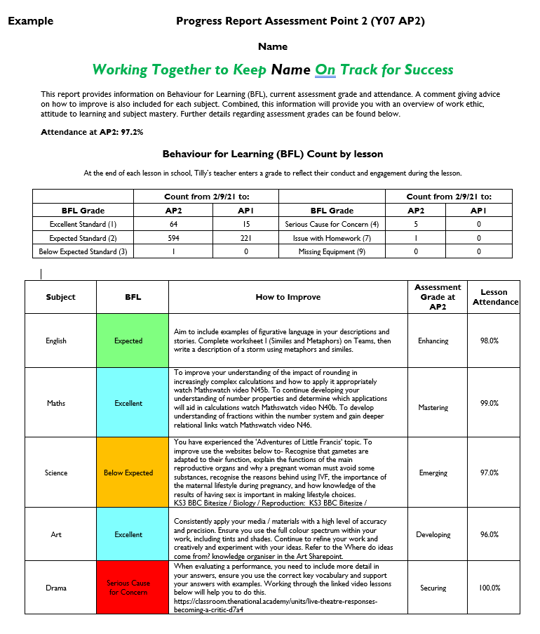
1a) Attendance to School
2) This is tally of Behaviour for Learning grades awarded each lesson.
1b) Attendance to lessons
3) This is the typical Behaviour for Learning grade for each subject. Being either: Excellent, Expected, Below Expected or Serious Cause for Concern
4) Here you can find advice on how to improve
5) Current assessment grade for each subject is judged to be either: Mastering, Enhancing, Securing, Developing or Emerging
Further information on assessment grades can be found on the next slide

Slide 3
1a) Attendance to School
1b) Attendance to lessons

Slide 4
2) This is tally of Behaviour for Learning grades awarded each lesson.

Slide 5
3) This is the typical Behaviour for Learning grade for each subject. Being either: Excellent, Expected, Below Expected or Serious Cause for Concern

Slide 6
4) Here you can find advice on how to improve .

Slide 7
5) Current assessment grade for each subject is judged to be either: Mastering, Enhancing, Securing, Developing or Emerging
Further information on assessment grades can be found on the next slide

Slide 8
